Slide 1
Product Management and User Experience
Everything you need to know
Glen Lipka
http://commadot.com

Slide 2
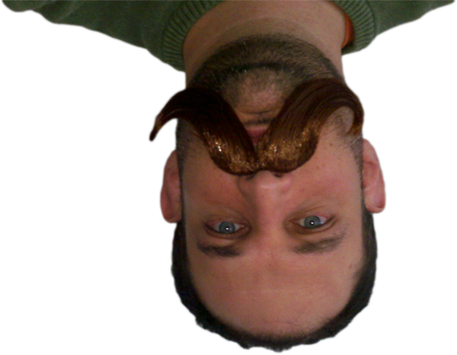
Glen Lipka
@glenlipka
http://commadot.com
Marketo
VP, User Experience
First hired employee
Sole Product Manager / Product Designer for 2 years
Interim VP, Product Management & UX
Intuit
One year of bureaucracy
Koko Interactive
1995-2002

Slide 3
We’re
Hiring!
Features
Easy workflow designer
Landing page / form / email WYSIWYG editors
Easy segmentation tools
Analytics
Full bidirectional CRM sync
Known for
One of the fastest growing startups in Silicon Valley
Great User Experience

Slide 4
Design is Decisions:
Who makes
the decisions?

Slide 5
The Product Manager
is the CEO of the Product

Slide 6
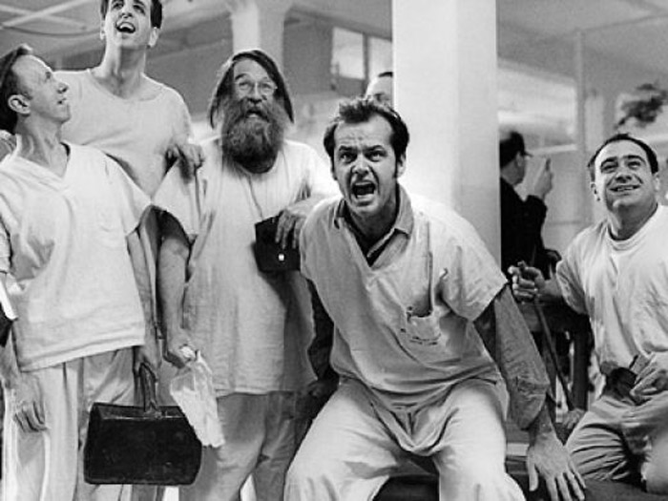
The Inmates are Running the Asylum
Notes:
http://www.amazon.com/Inmates-Are-Running-Asylum/dp/0672316498

Slide 7
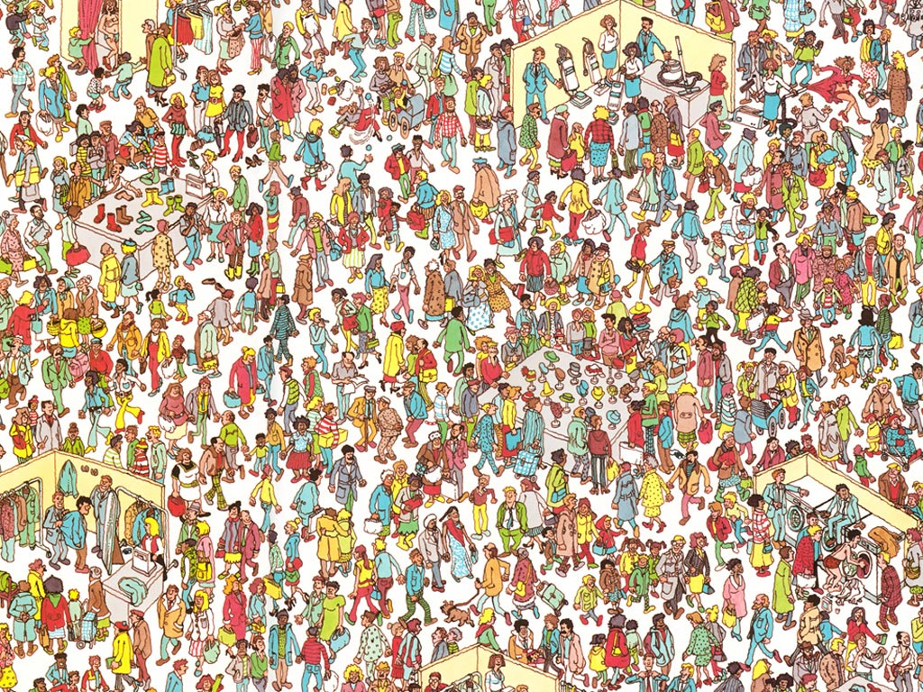
What about the UX designer?

Slide 8
Designers are sad

Slide 9
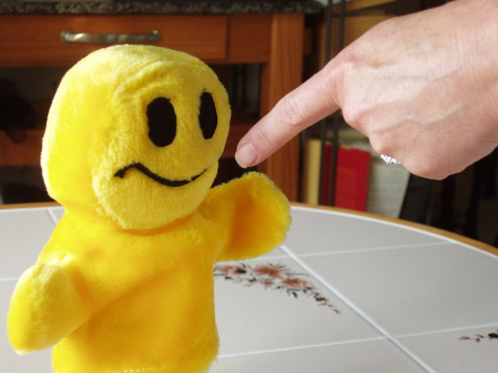
Designers are told

Slide 10
Designers have
no real responsibility
or authority

Slide 11
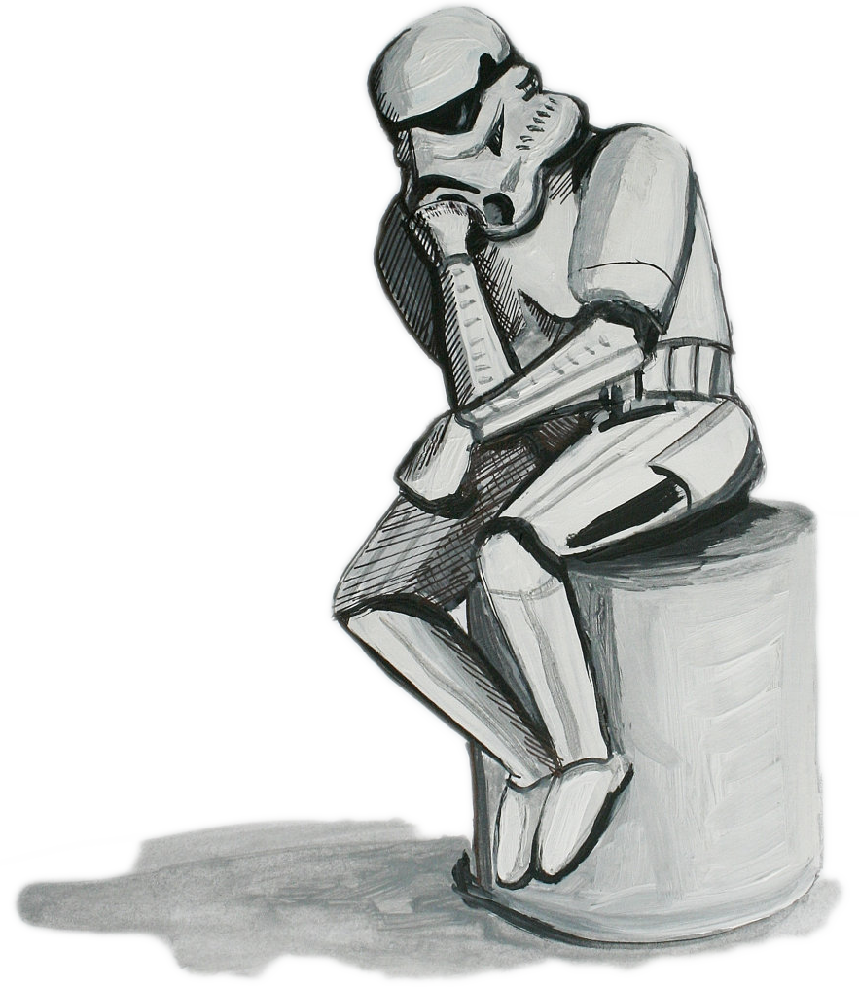
What should UX be responsible for?
Is that the
UX Designer
I am looking for?

Slide 12
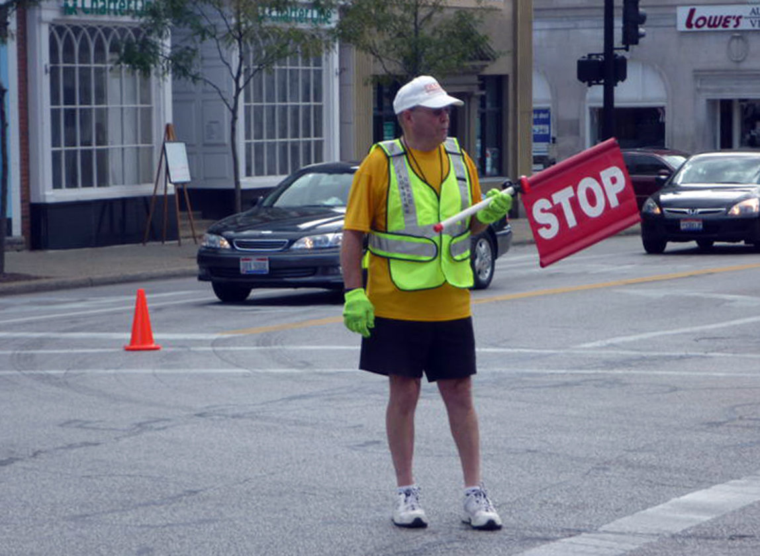
Not a UX Designer

Slide 13
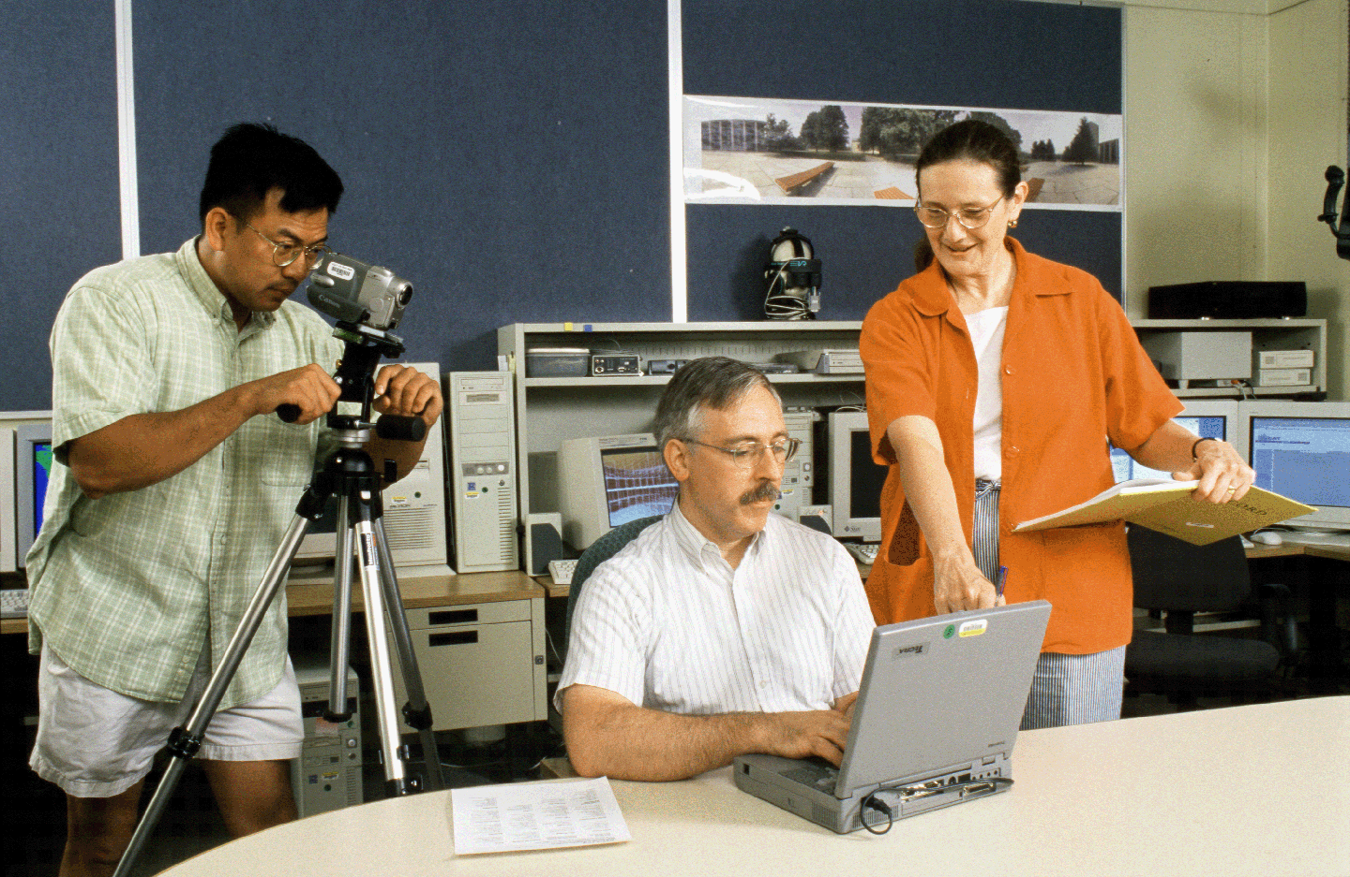
Not UX Designers

Slide 14
Not a UX Designer

Slide 15
Glen’s UX Designer Definition
The one who writes the PRD

Slide 16
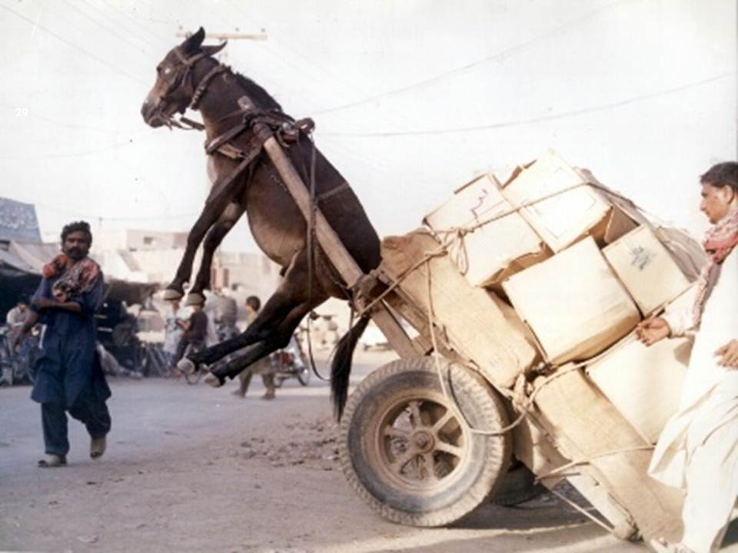
I am just
a graphic designer!
PRD
PRD
PRD
PRD
Details
PRD
Decisions

Slide 17
Product Designer
Product Manager
Product Manager
But am I a Good Product Designer?

Slide 18
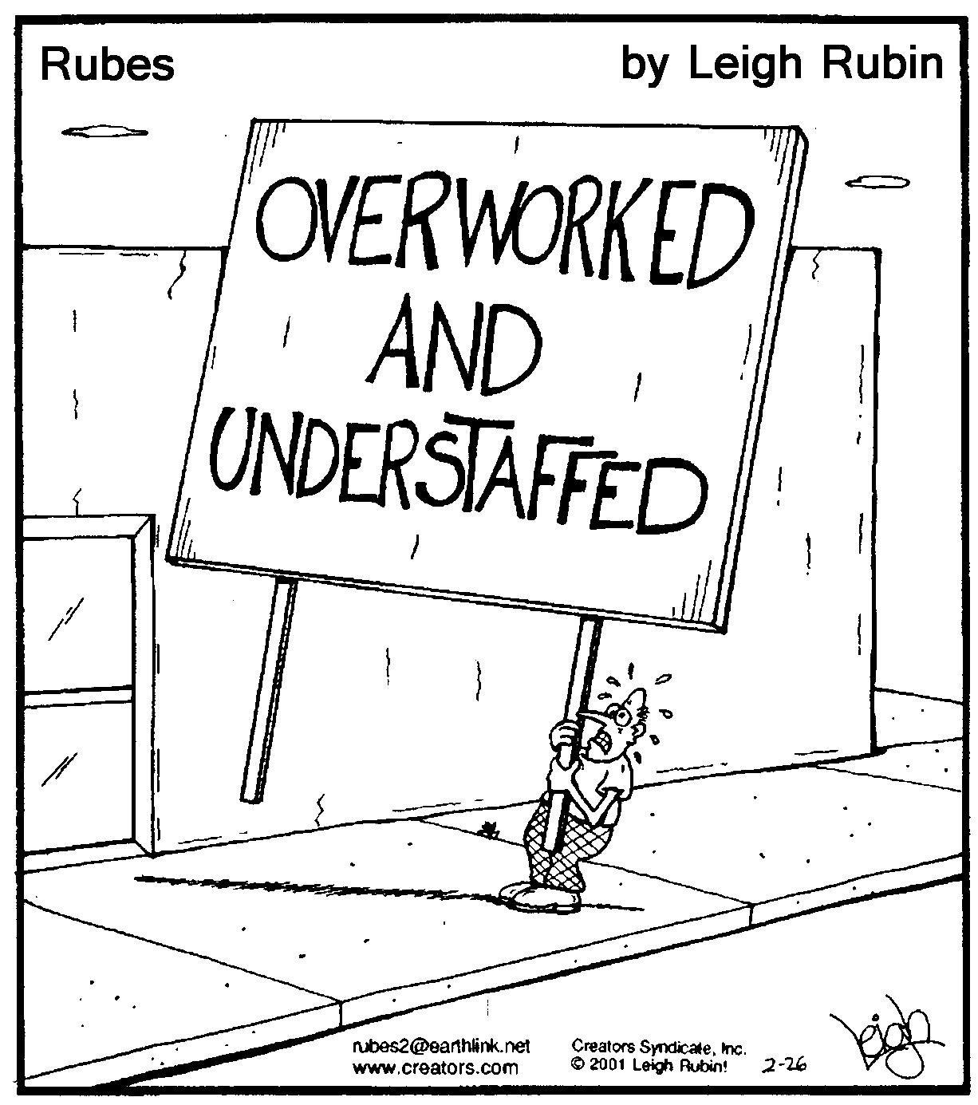
Product Management
Roadmap
Competitive Analysis
Business Cases
Prioritization
MRDs
PRDs
Go to Market
Partnerships
Internal Training
Backlog
Ultimate Responsibility

Slide 19
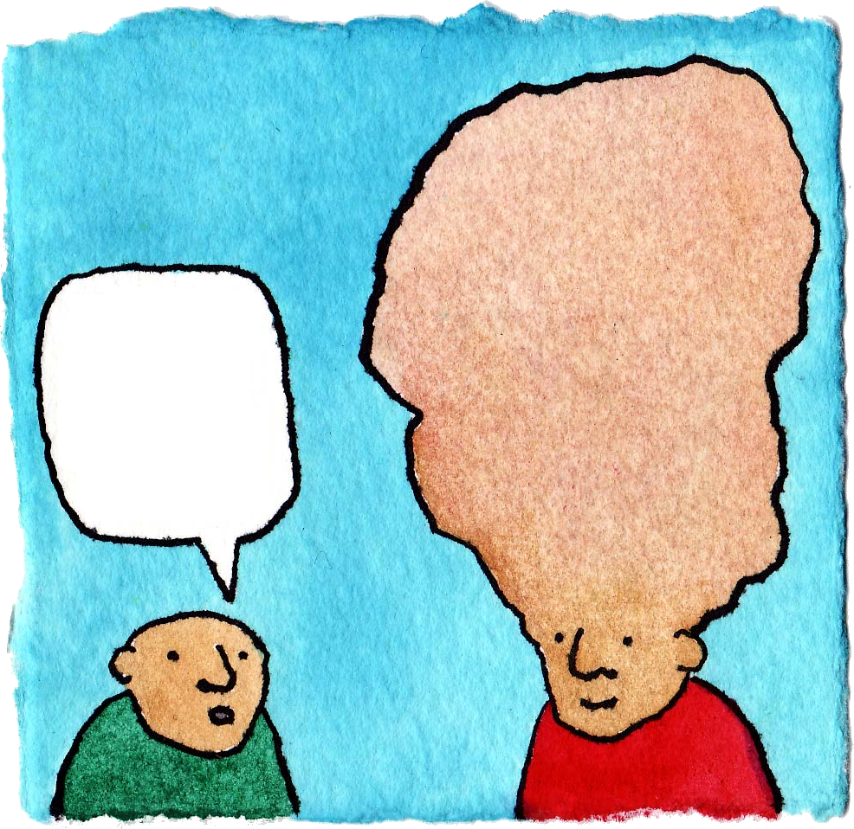
UX Designers should write
the PRDs!
What should UX Do?

Slide 20
UX Designers at Marketo
Sit with engineers
Are detail oriented
Are responsible for the PRDs
Iterate / Collaborate on ALL details with
Engineering
Product Management
Marketing
Customers

Slide 21
Key question:
How does this affect the MRD?

Slide 22
Ideal MRDs
Overview
Vision statement
Rough Timeline
Priority
Competitive Landscape
Competitor Name
Features
Screenshots
Pricing
Strengths/Weaknesses
Reviews
Customer Quotes
Interview List (people who used competitive product) – with photos
History (Log new features or changes in business dynamics)
Other notables
Packaging
How this relates to existing products
Pricing
Sold separately? Dependencies?
Research (analysts)
Go to Market Strategy
Marketing narrative
Product marketing plan
Internal education plan
External education plan
Event/Tradeshow dependencies
Related Features
Research
Interview List (prospects, friendlies, analysts, etc) – with photos
Other research

Slide 23
Design Driven PRDs
What do
they look like?

Slide 24
Admin | Logged in as: Demo User | Logout
QuickJump…
My Marketo
Marketing Activities
Design Studio
Lead Database
Analytics
Free Trial Scenario
Budget
Schedule
Flow
Campaign Log
Smart List
Campaign Menu
Run Flow test
Drag Items to Create Smart List
Smart List Rules
Smart List Define who is part of this campaign
Triggers
Fills out form
Visits Page
Drag action from the left
Opens Email
Clicks on Email
Registers for Event
Data Value Changes
Filters
User History
Filled Out Form
Filled Out Form
Visited Page
Important. This will help users understand the inline editing paradigm
Opened Email
Clicked on Email
Was sent email
Field Changed
Auto-save ON
Last Saved: Aug 12, 12:42pm
Done
Personal Attributes
Company Attributes

Slide 25
Salesforce Campaign Sync
Campaign:
Create New SFDC Campaign
None
Create New SFDC Campaign
Rock The Revenue
Marketo Masters
Name information not displayed if pre-existing campaign selected
Pre-populate with Program Name
Name:
Start Date:
End Date
Campaign Status:
Description:
Big Launch Webinar
Pre-populate dates with Event date if set
Read only fields if selecting a pre-existing campaign
Planned
Planned
In Progress
Completed
Aborted
This will Replace SFDC campaign member status with progression status
This will skip SFDC campaign flow actions. Learn More
Mark required fields in SFDC as required in Modal as well
Display all required fields from sFDC side in addition to these ones.
Save
Cancel
Only active SFDC campaigns display
If multiple campaigns with the same name: show the ID in parens after. (ONLY for this scenario)
Can’t pick a SFDC Campaign already sync’d with a different program
Campaigns with existing SYNC relationships CAN show up in the list, but can not be saved. The purpose is to show them the name of the program that is already sync’d. Use Status of Already used by Program Name. (as a link)

Slide 26
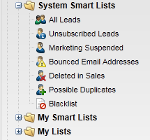
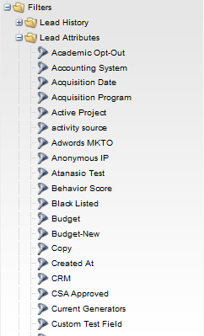
Show all leads who qualify for smart list
Big Finance Rules
Not available in Member of Smart Lists
List Actions
Segmentations
Filters allowed: 1) Lead attributes
2) Company attributes
3) Member of Program, Member of Smart Campaign, Member of List
4) Has Opportunity
5) Salesforce filters
Nice to have:
Formula fields
Not allowed:
Lead history filters
Industry
Health
Big Finance
Small Finance
Government
On approval, “Industry Segment=Big Finance” for all leads in smart list (apply priority)

Slide 27
Wait Until with Tokens
Wait Until with Tokens
Tokens upgraded to take “modify” parameter
Either inline like below or same thing in the My Tokens tab.
Optional UI: My Tokens to add parameter in edit modal of token
Examples:
{{my.ReminderDate:modify=+2bd}} //business days
{{lead.SignUpDate:modify=+6m}}
{{system.Date:modify=+1y}}
1. Wait Until
Wait:
{{my.ReminderDate:modify=+2bd}}

Slide 28
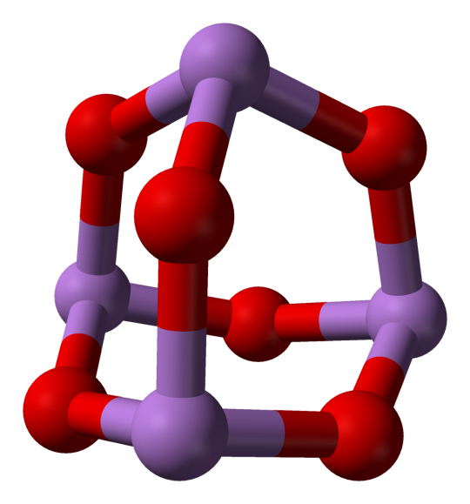
Structure matters
How are you organized?

Slide 29
The Pixel Pushers
CEO
Head of Products
Product Management
Engineering
CMO
Graphic Design
Marketing
Notes:
The polishers

Slide 30
The Assistants
CEO
Head of Products
Product Management
Engineering
CMO
Marketing
Usability
Notes:
The assistant

Slide 31
The Standards People
CEO
Head of Products
Product Management
Engineering
CMO
Marketing
CIO
UX Design
Notes:
The peer

Slide 32
CEO
Head of Products
Product Management
UX Design
CMO
Marketing
Engineering
Ideal Structure
Notes:
The peer

Slide 33
Summary
PRD = Details

Slide 34
User Experience 101
11 UX Principles

Slide 35
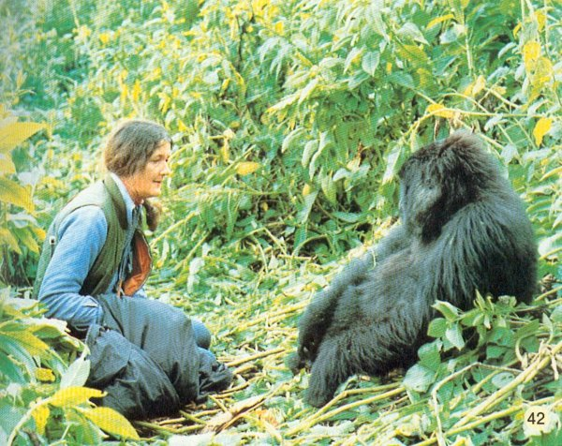
User Research

Slide 36
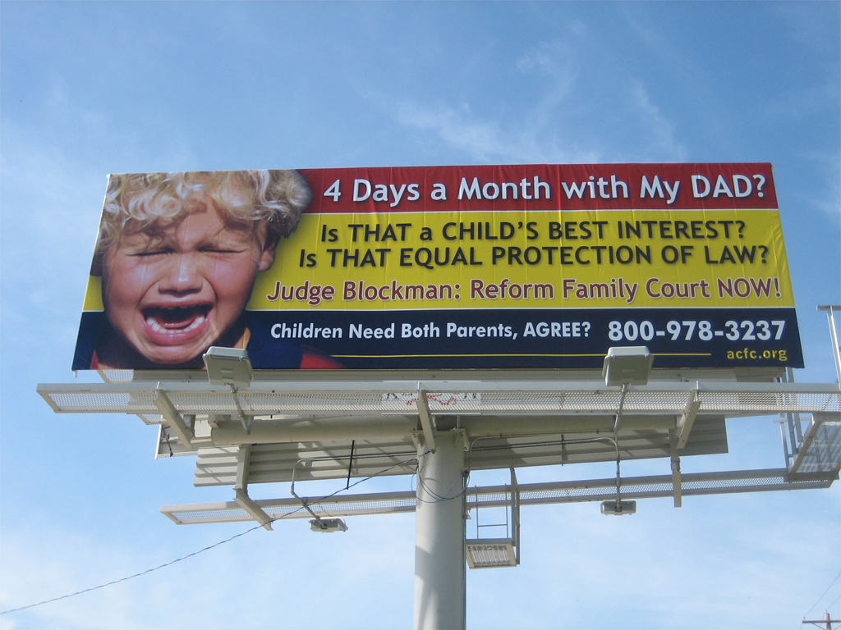
People don’t read

Slide 37
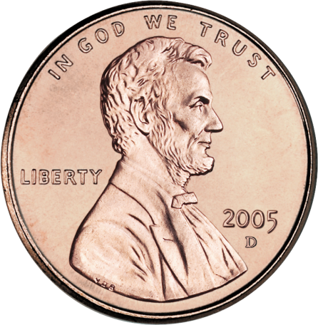
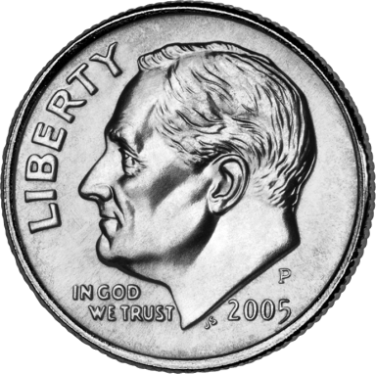
Which is better?

Slide 38
User
Blocker
Remove System Friction
Goal

Slide 39
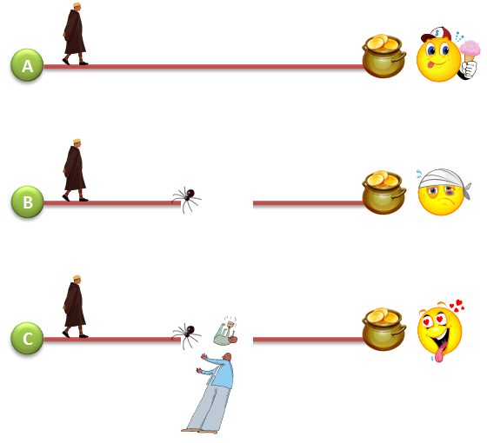
3 Travelers

Slide 40
Local Max Island

Slide 41
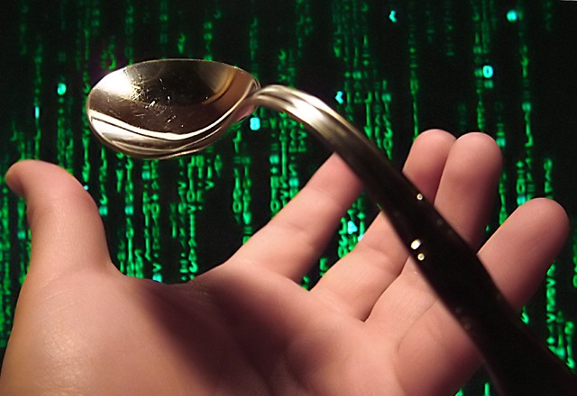
Don’t Bend Users

Slide 42
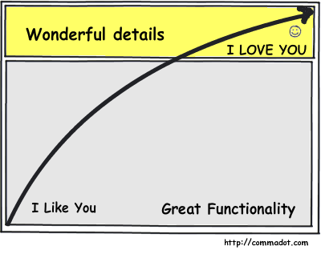
Like you… Love You

Slide 43
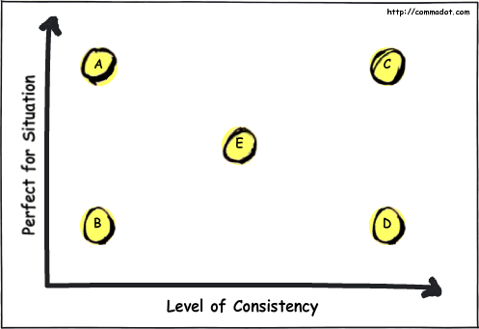
Consistency is Better

Slide 44
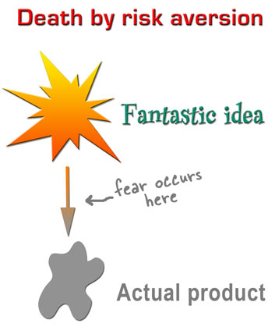
Illustration by http://headrush.typepad.com/

Slide 45
Notes:
Names, munchnkin, borks, smartCampaigns.
Applications should be loveable

Slide 46
Thank You
@glenlipka
http://commadot.com
Questions?

